Slide 1

SAP BTP ABAP on Cloud / RAP Training
DAY-2
Anubhav Oberoy
www.AnubhavTrainings.com
Follow excellence with sheer passion

Slide 2


DISCLAIMER
The training content and delivery of this presentation is confidential, and cannot be recorded, or copied and distributed to any third party, without the written consent of Anubhav Trainings

Slide 3
Agenda
01
BTP Use cases
02
What is HANA
03
HANA v/s S/4HANA
04
CDS Introduction
www.anubhavtrainings.com

Slide 4

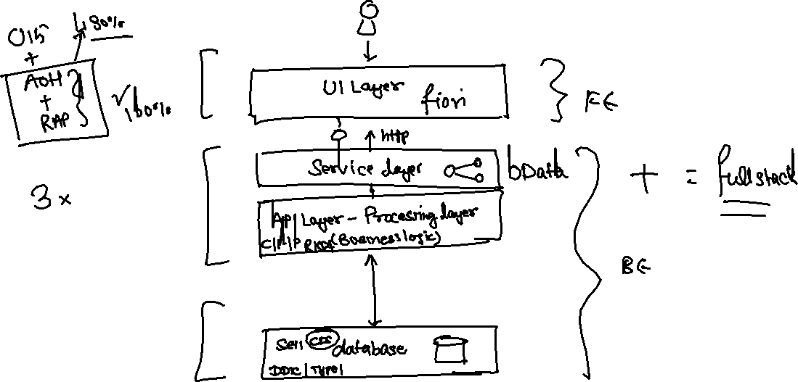
Use cases 1 – Building Full Stack Application
www.anubhavtrainings.com

Slide 5
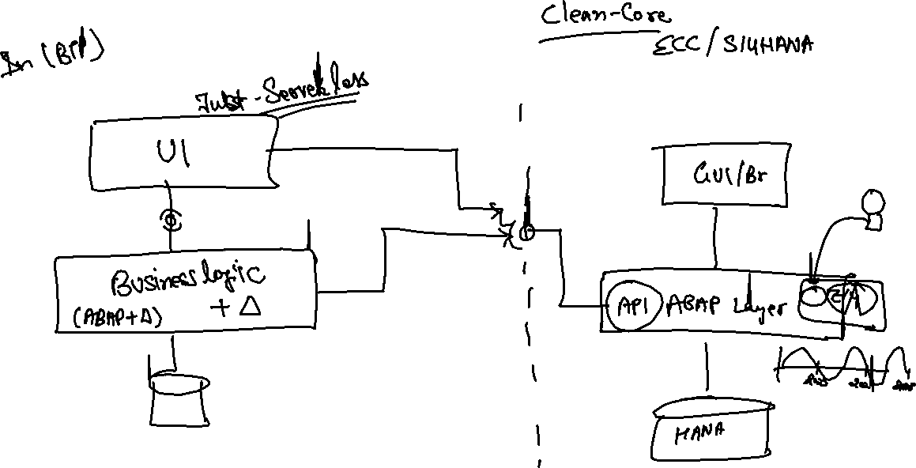
Use Case 2 – Side by Side Extension
www.anubhavtrainings.com

Slide 6
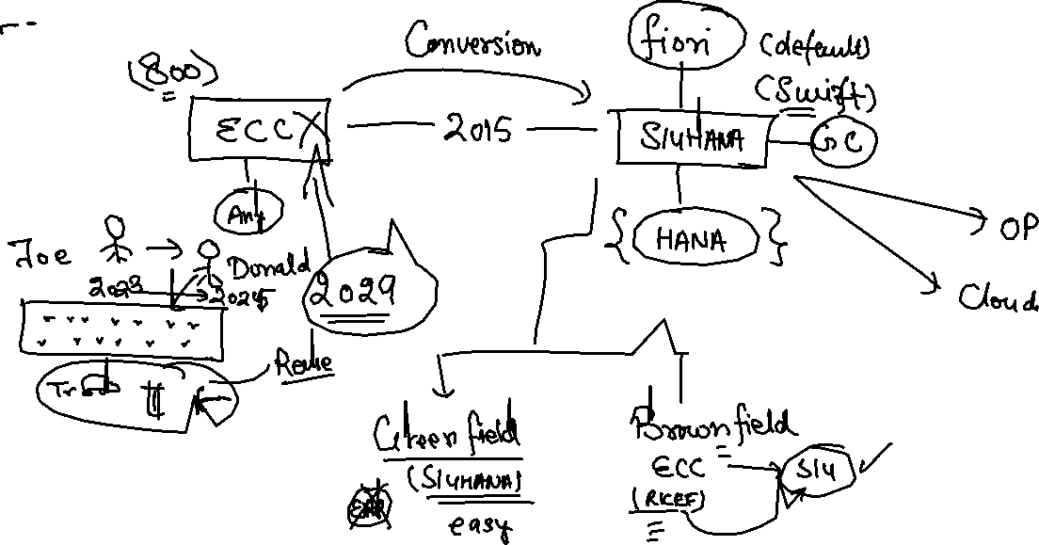
Use Case 3 – S/4HANA Cloud Extension
S – Simplification 4 – 4th Generation ERP
S/4HANA – Onpremise, Cloud
www.anubhavtrainings.com

Slide 7
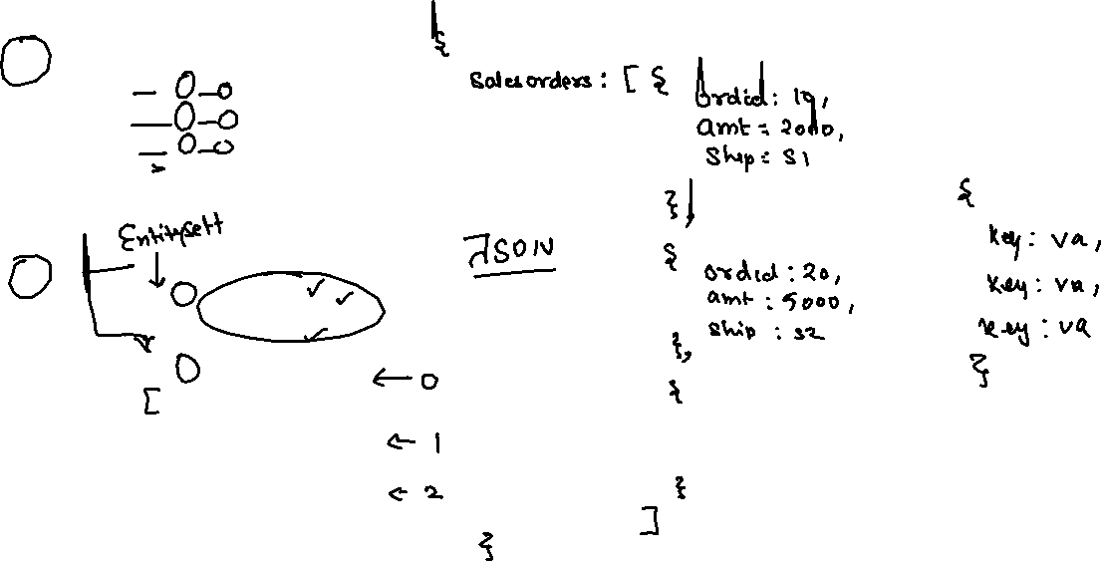
JSON – Java Script Object Notation
It is a light weight data format to transmit data from one system (peer) to another system.
{
“prop”: val,
“prop”: val,
“prop”: val,
“prop”: val,
…
}
{
“empStr”: { “empId”:1001,
“empName”:”Anubhav”,
“salary”: 5000
},
“empTab”: [ {“empId”:1001,
“empName”:”Anubhav”,
“salary”: 5000
} , {“empId”:1001,
“empName”:”Anubhav”,
“salary”: 5000
} , {“empId”:1001,
“empName”:”Anubhav”,
“salary”: 5000
}
]
}
www.anubhavtrainings.com

Slide 8
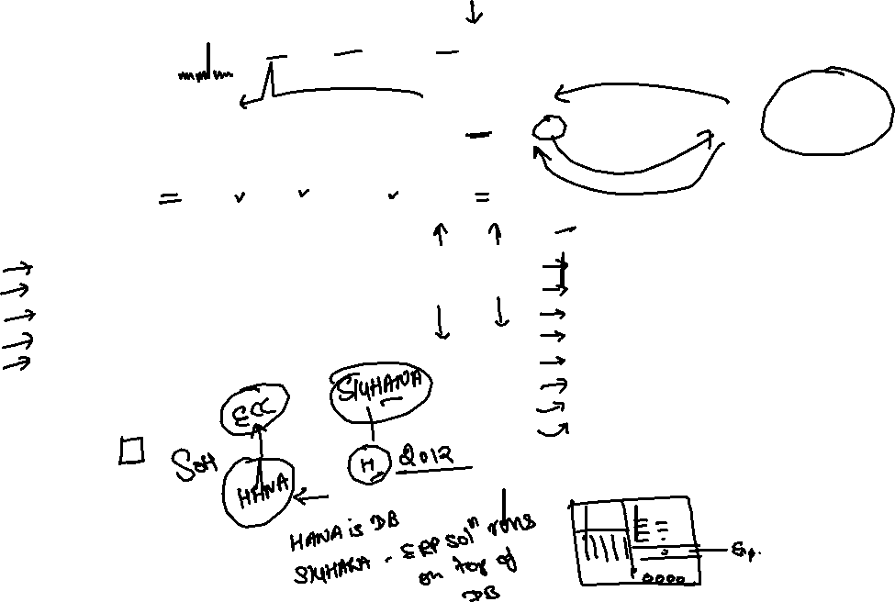
Introduction to HANA
HANA stands for High Performance Analytical Appliance. It SAP’s in-memory database.
CPU
RAM
HDD
Appliance = Hardware (Dell, Lenovo and HP) + Software
Hardware innovation Software innovation
C
C
Row v.s Column store
No need to maintain secondary indexes
We can aggregate the data on-fly
Compression of data
Partitioning of data
Massive parallel processing using multi-core CPU
No need to maintain large change records
Insert-only approach (compliance)
Cost of memory came down <~50k USD
Powerful backup systems
Ability to deliver multi-core cpu
Able to fabricate large memory at portable
64-bit OS - microprocessor
C
C
www.anubhavtrainings.com
7

Slide 9















Row store v/s Column Store (Behind scenes)
1001 | SHIP1 | MAT1 | 500 | USD | 1002 | SHIP1 | MAT2 | 300 | USD
1003 | SHIP2 | MAT2 | 900 | USD | 1004 | SHIP2 | MAT1 | 500 | USD
What is the total sales in my company?
DB has to scan all the cells of all the rows and extract the amount field to total. This consumes lots of time.
When we get data in column, since less cells are scanned, we will get the total much faster.
Bring me all columns, all rows – SELECT * FROM tab
Aggregation – SUM, MIN, MAX, AVG, COUNT
1001
1002
1003
1004
SHIP1
SHIP1
SHIP2
SHIP2
MAT1
MAT2
MAT2
MAT1
500
300
900
500
USD
USD
USD
USD
www.anubhavtrainings.com
7

Slide 10
When to choose Row or When to choose Column
Row Store Column Store
If the SELECT * on our table is unavoidable
When we do have most values as unique values
If the data volume in table is low
Table has more WRITE operations then READ operation
Usually org tables, configuration tables
The guidelines of choosing row is strict
If we want to apply the Aggregation on data (SUM, MIN, MAX, AVG, COUNT)
When our table columns have duplicate values which is very true in sap in tables which store master and transaction data (compression will be good)
SAP have already changed most of their tables to column store which means it’s a best practice
Volume of table data is very high
We read table more often then write which is true also in a typical system we write more SELECT query then INSERT, MODIFY
www.anubhavtrainings.com
7

Slide 11


Developer’s view – what it means for my life?
Presentation layer
Selection screen
Data object
SELECT * FROM db INTO itab
LOOP process data
Display data to user
Application layer
SAP Netweaver
Database
HANA ~50k$
Code to data paradigm or code push down
www.anubhavtrainings.com
7

Slide 12
Evolution of HANA
2014
BW on HANA
Project Orange
BW 7.31
ECC
driver
Oracle
HANA
HANA
copy
ABAP on HANA (developer)
Technology : Petrol Engine
Side-car approach
Maruti Swift
S/4HANA
Sep 2015
S – Simplified
4 – 4th generation ERP
Completely new ERP solution by SAP
ONLY HANA
S/4HANA
NW7.4
ECC
NW7.4
Suite on HANA
2014Dec-2015
Maruti 800
By 2029 = out of maintenance
HANA
HANA
www.anubhavtrainings.com
7

Slide 13
EPM Data Model – Enterprise Procurement Model
It’s a demo data model for the purpose of learning, training, testing, scenarios, and demos. It contains over 72 tables and 100+ Function modules for development.
Sales Order
Sales Order Items
3 Laptops
2 HDD
1 iPhone
ITeIO
(amazon)
Purchase order
Purchase Order Items
30 Laptops
200 HDD
1000 iPhone
Customers
Suppliers
Invoice
Invoice Items
1 Laptops
1 HDD
1 iPhone
stock
Business partners
Products
7
www.anubhavtrainings.com

Slide 14
CDS – Core Data & Services
CDS is the new approach of building semantically rich data models. It is an extension of SQL in ABAP world.
What has been extended?
DDL – Data definition language – design new data models – new tables, structures
DQL – Data Query Language (CDS Views and CDS Entities) – new views to extract data (agg., join, load, calculate,formulas)
DEL – Data Expression language (expressions like path expression, case expressions)
DCL – Data Control Language (security)
Since in ABAP on Cloud Environment we do not have GUI access (no access to SE11) – we will use CDS
Naming convention – is a best practice to follow in a project. ZCOMPANY_PROJ_OBJTTP_NAME
ZDXC_XX_*
We will use an uploader utility provided by SAP, get this in our ABAP on Cloud System to test it
Install the abap git plugin so we can interact with github from our adt tool - http://eclipse.abapgit.org/updatesite/
Download the code from SAP standard repository - https://github.com/SAP-samples/abap-file-uploader
Register a service
Run the utility
www.anubhavtrainings.com

Slide 15
New ABAP Syntax
SAP ABAP is improving over the time so that we as a developer can write optimized abap code which take less effort to do more. For example avoid looks, merge multiple lines in one code line, make abap easy to read and understand, improve performance and code look similar to other programming language.
Disclaimer: New ABAP syntax does not mean that you have to change all the old code written in past, you always have backward compatibility. All the new code which you plan to develop in future, use new syntax and keep all the OLD code as it is. NW>=740
New language feature
New SQL syntax
Inline data declaration
Inline field symbol declaration
String operator
Value expression
Corresponding expression
Constructor expression
Table expression
Smart loops over a table
Condition expression
Loop itab row as a object
Select columns with comma
Escaping of host variables
String literals in queries
New SQL functions
Case expression
Aggregate functions in having clause
Select on internal table
www.anubhavtrainings.com
7

Slide 16

What We Did
Let’s Summarize
www.anubhavtrainings.com

Slide 17
www.anubhavtrainings.com
Thank You
End of Day 1
www.anubhavtrainings.com

Slide 18


We’re committed to empower you to be
#FutureReady
through powerful training solutions.
We build the workforce of the future.
250+
Corporate Clients
30,000+
Learners Trained
25000+
Learners Placed
FREE WEBINARS
Sign up for free webinars with industry experts every fortnight!
Enroll Now!
Contact us today!
https://anubhavtrainings.com

